Slide 1
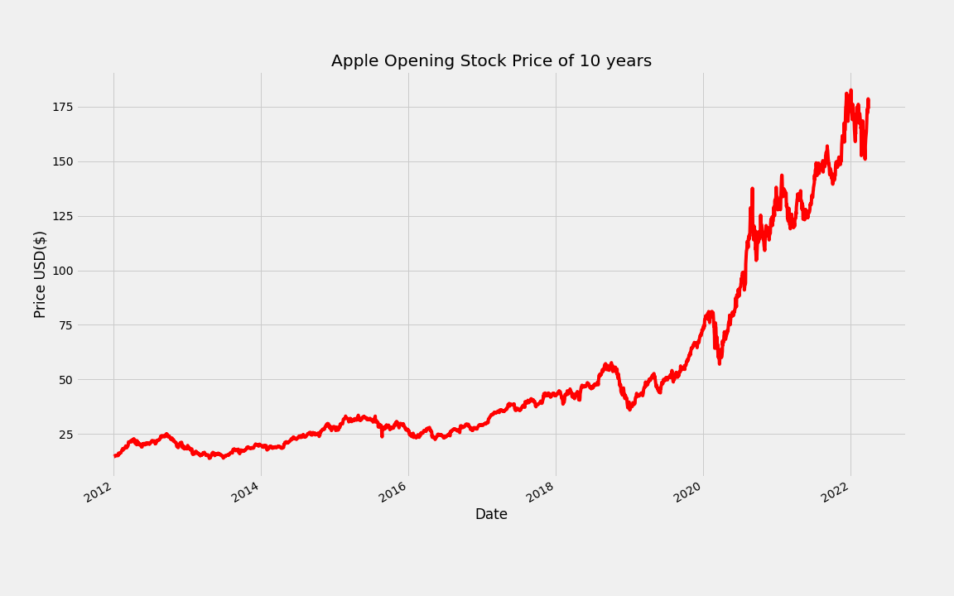
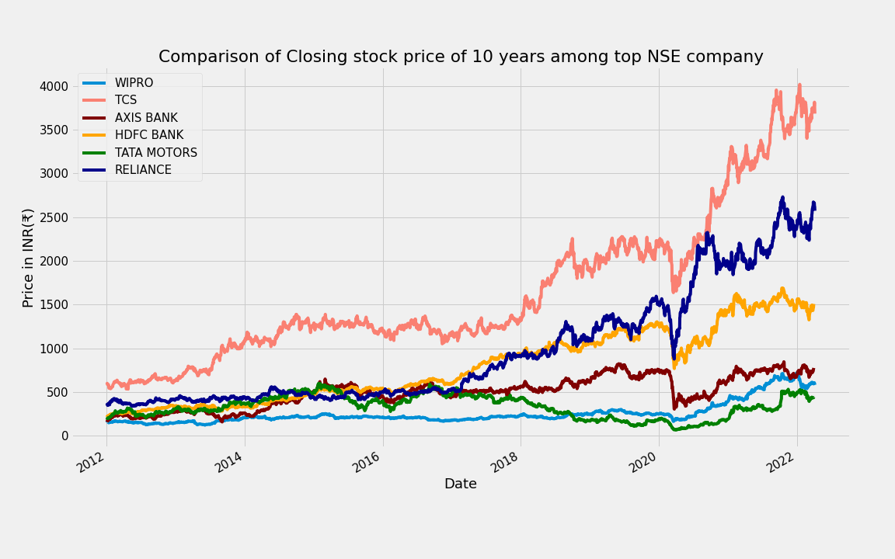
Stock Price Prediction
By
Saheb Mukherjee(11571020039)
Sayan Das (11571020040)
Under the supervision of
Mr. Abhijit Bhattacharya
Asst. Prof. Dept. of Computer Applications
B. P. Poddar Institute of Management and Technology

Slide 2

Context
Introduction
Objective
Incentive
Tools used:-
Software
Hardware
Methodology
Module
EDA
Modelling
Algorithm
Implementation steps
Testing
Conclusion
Future scope
Reference

Slide 3
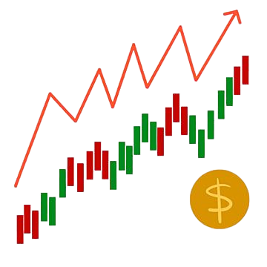
INTRODUCTION:-
A stock market is a place where people buy/sell shares or stocks of publicly listed companies
It is a widely used source for people to invest money in companies with high growth potential.
Stock market is a very risky place where it is most likely that you will face some amount of loss at a point of time.
So our aim is to minimize this risk and provide support to the investors
The paper focuses on the use of Regression technique using LSTM based Machine learning technology to predict the closing stock values.

Slide 4

OBJECTIVE:-
The main objective is to collect the streaming Data of 10 years through web scrapping technique using a python library `pandas_datareader`
The Data that would be collected will be the user demand data and it could be of any stock exchange company.
After that we would be visualizing the important features to under the data.
Next step would be pre-processing of data.
Then the LSTM algorithms will find patterns in the data and use regression method to predict the future ups and downs of the closing stock price of that particular company.
Finally it would generate 3 graphs as an output which we will be discussing in upcoming slides.

Slide 5

Incentive:
Predicting stock performance is a very large and profitable area of study
Many companies have developed stock predictors based on neural networks
This technique has proven successful in aiding the decisions of investors
Can give an edge to beginning investors who don’t have a lifetime of experience

Slide 6
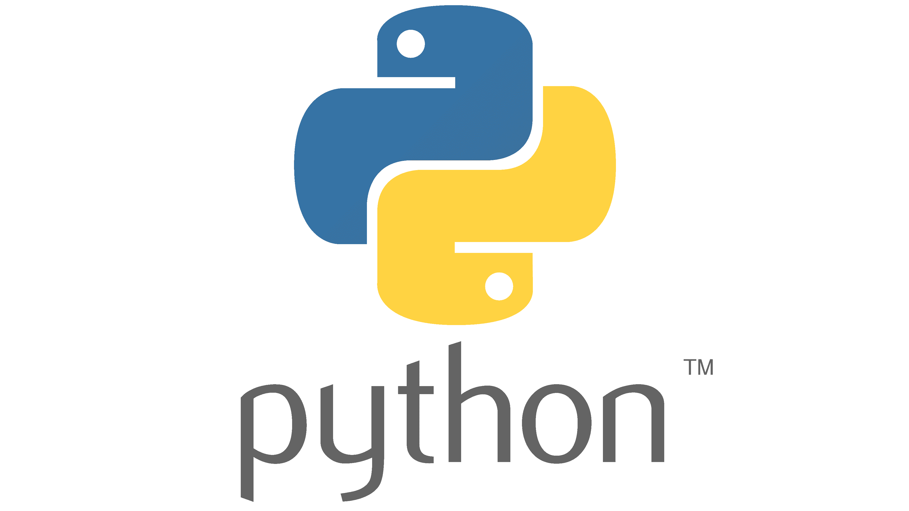
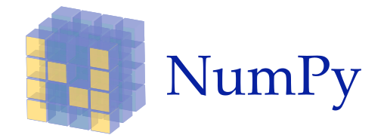

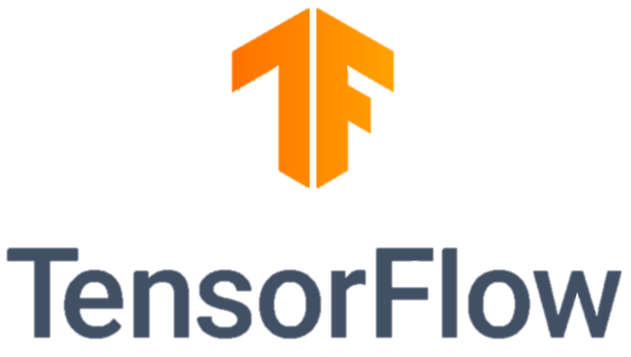


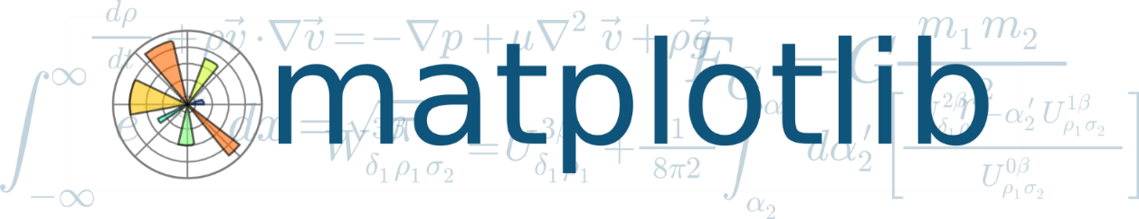

Tools Used (Software & Hardware):
Software Architecture:
python 3
Anaconda Prompt
Jupyter notebook
Scikit Learn
TensorFlow
keras
Pandas
Pandas_datareader
NumPy
Matplotlib
Seaborn
Chrome Browser
Hardware Architecture:
Processer: Intel i3,15
RAM: 8 GB
Hard Disk: 1 TB
Internet Connection

Slide 7

Methodology:
Here, we have choose a model called LSTM to build our Project
LSTM stands for Long Short Term Memory.
Unlike other models LSTM is special it gains the information from previous steps in a loop.
Having the previously learned information it can predict complex prediction way better than other models.
LSTM is widely used in NLP technology, but it is also going to work excellently in our problem of predicting stock price as well.

Slide 8
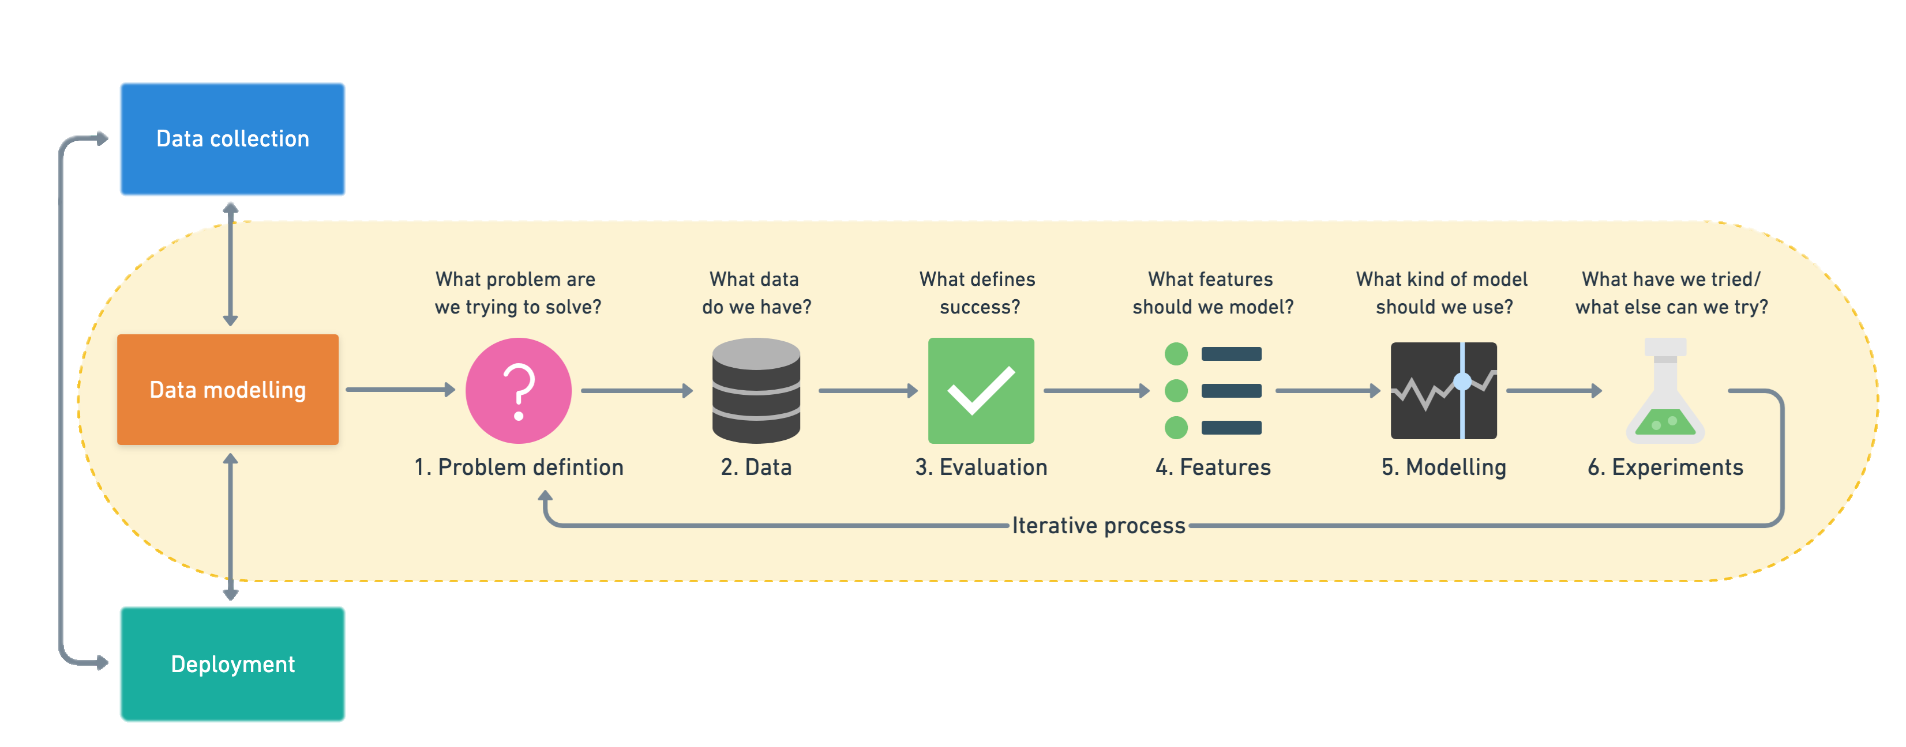
Module:-

Slide 9

Modelling:
In here we used LSTM model for train and testing the data,
The proposed framework that learns online, anticipating the close costs of the stock with the assistance of Long Short-Term Memory (LSTM).
The reason they work so well is that LSTM can store past important information and forget the information that is not.
LSTMs are widely used for sequence prediction problems and have proven to be extremely effective.
Various parameters of the LSTM model can be tweaked, such as the number of LSTM layers, the dropout value, and the number of epochs.
LSTM architecture comprises the cell, input gate, output gate and forget gate.

Slide 10

Algorithm:
Step 1: Start the python ‘stock_pred.ipynb’ in any Jupyter notebook IDE. Like anaconda or colab.
Step 2: Data visualization and Pre-processing into train and test set after getting the historic data from the market for a particular share.
Step 3: do a feature scaling on the data so that the data values will vary from 0 and 1, using minmax_scaller from the module sk_learn.
Step 4: Creating a data structure will be a 3D matrix containing [(no. of sample), (no. of time step), (no. of features)] as the feature set and the closing value will be the target set.
Step 5: Building the LSTM Model for Step 5 data set and setting up the hyperparameters.
Like setting the no of layers setting up the loss function and optimization technique, batch_size and finally the no of epochs.
Step 6: fit the train data for training.
Step 7: Setting up test data and for predictions and Evaluating the overall model performance by using RSME and R-Square methods and also visualizing the predictions with the actual results in matplotlib.
Step 8: Predicting of the future data based upon the last update stock value.

Slide 11
Implementation Steps:
Step1:
Raw Stock Dataset: Day-wise, past stock prices of selected companies are collected from the YahooFinance official website.
Step2:
Pre-processing: This step incorporates the following:
a) Feature Engineering: Part of data reduction but with particular importance, especially for numerical data.
b) Data cleaning: Because it is a data from official site, the data is very clean and structure so no Data cleaning is needed.
c) Data integration: Integration of data files. After the dataset is transformed into a clean dataset, the dataset is divided into training and testing sets to evaluate. Creating a data structure with 60 timesteps and 1 output
Step3:
Generating the output data and plotting it in understandable graphical format using the trained and tested model.

Slide 12
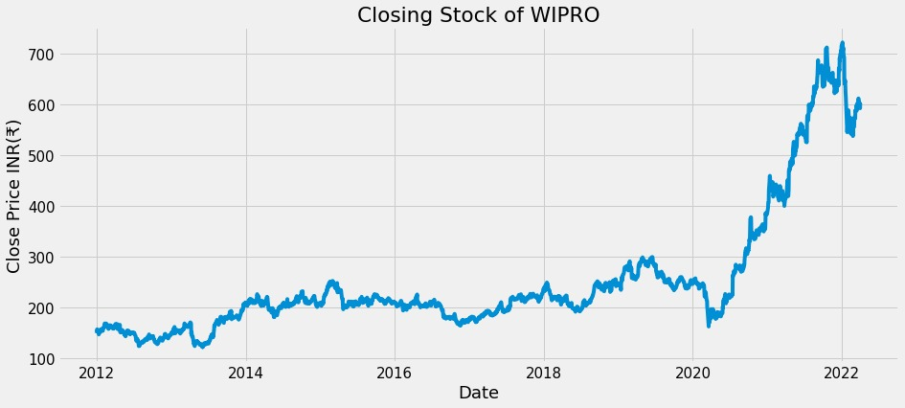
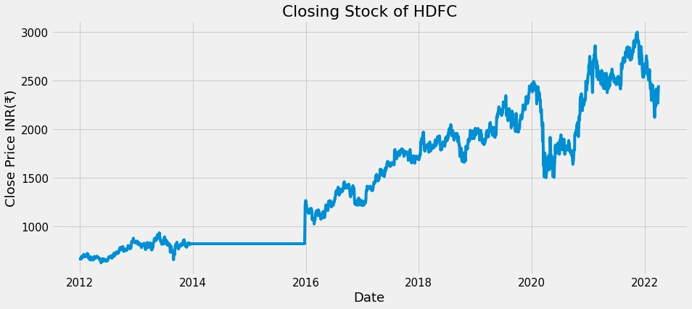
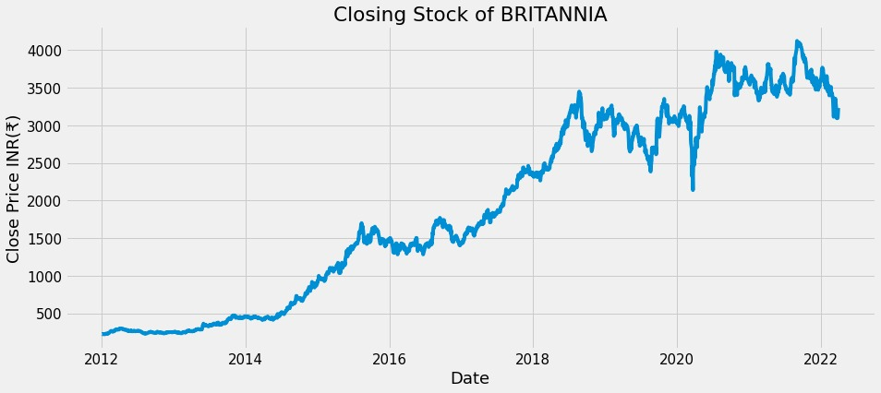
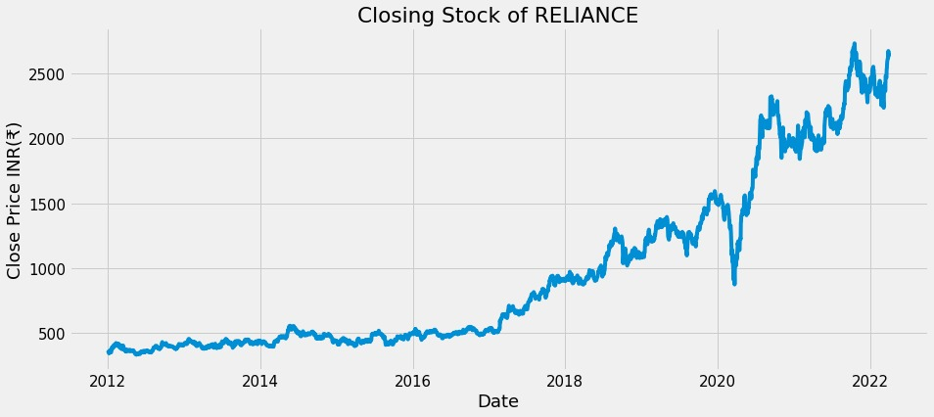
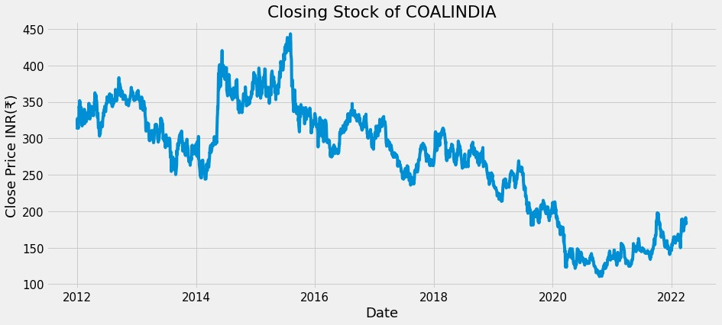
OUTPUTS DISCUSION:

Slide 13
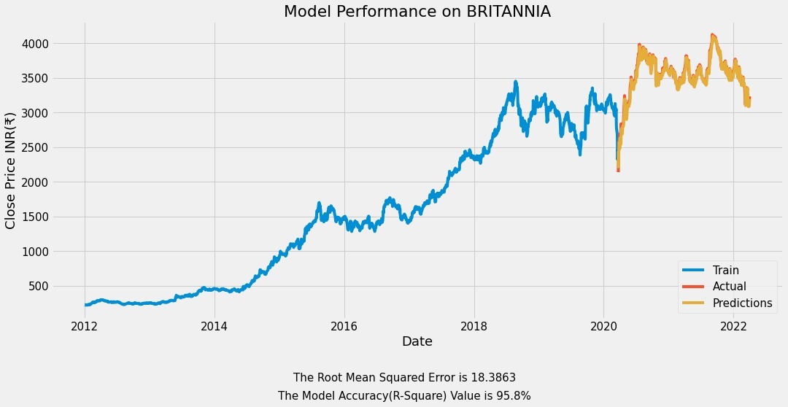
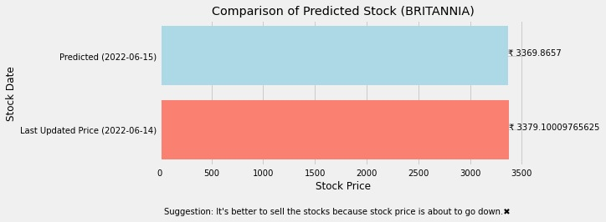

Slide 14
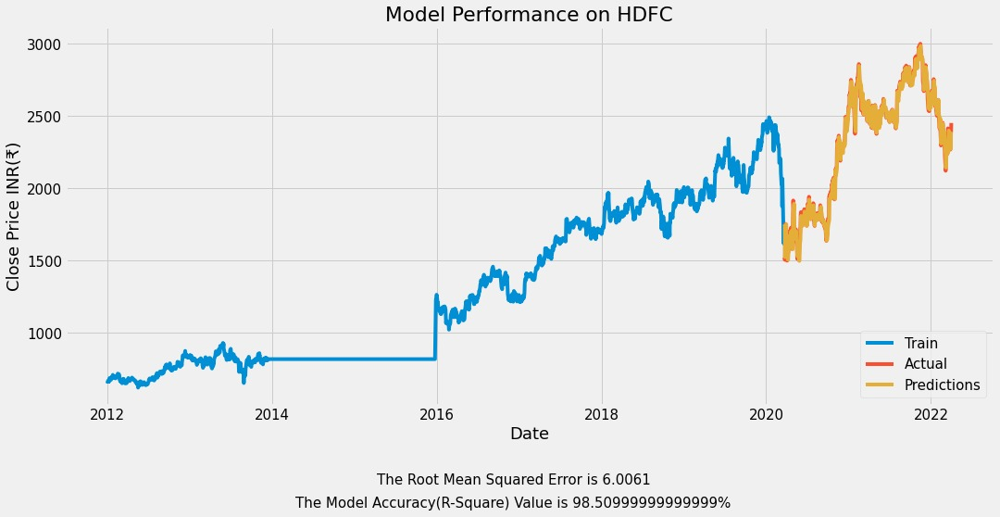
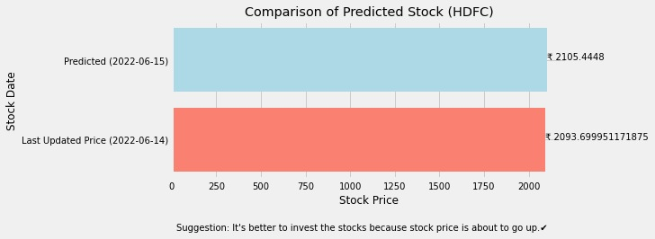

Slide 15
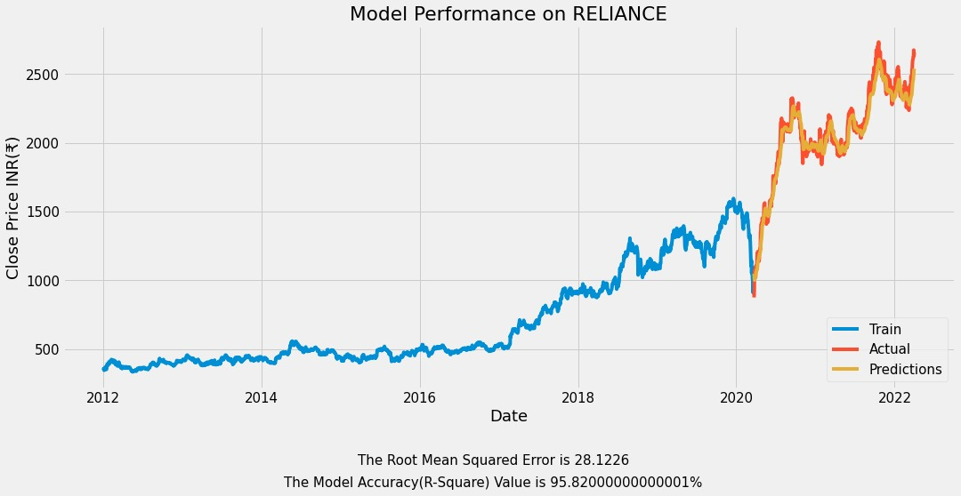


Slide 16
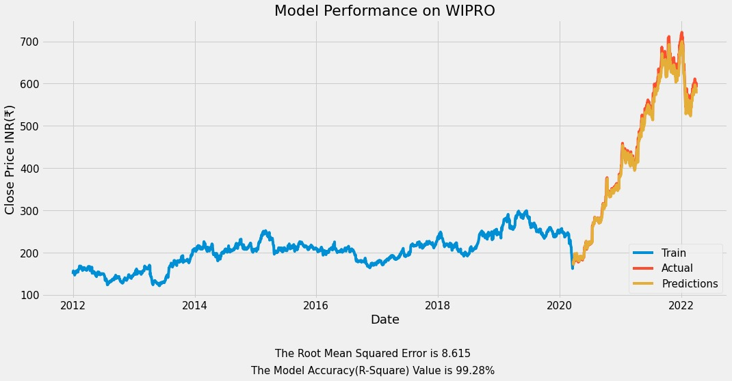
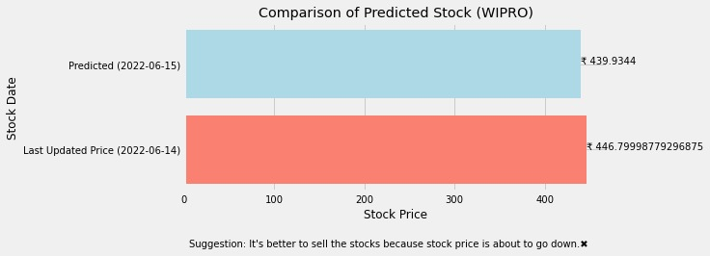

Slide 17
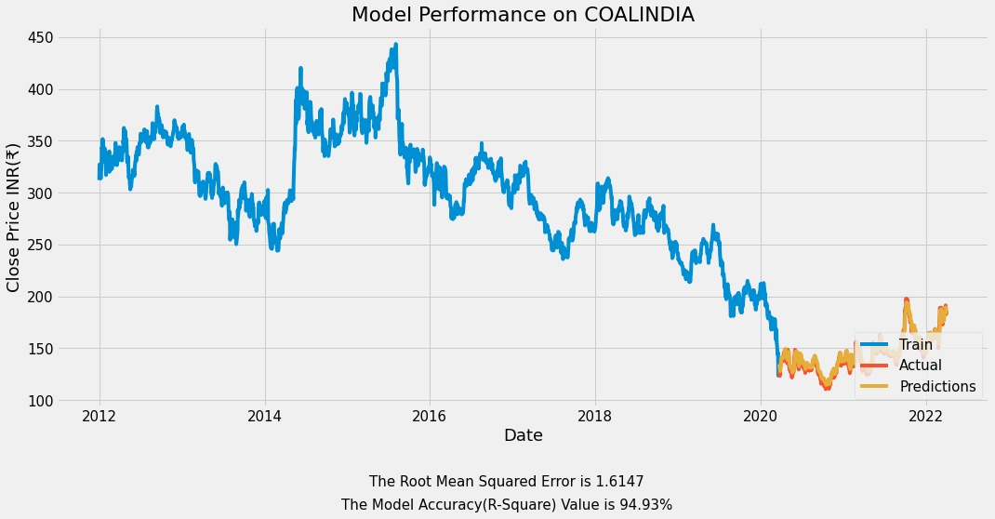
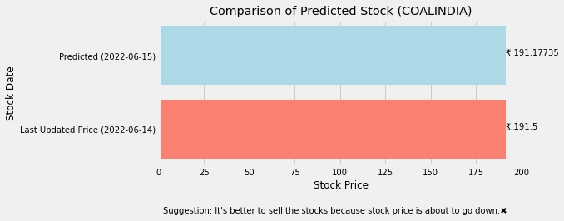

Slide 18

Testing :
This program is scrapping data from a trusted website that is Yahoo finance to get the stock data by using a web api. So, the data in which we are working has been verified.
The data in which we are working can be classified as time series data, so to predict a time series data we are using a RNN algorithm that is LSTM which is tested by various developers and has been their first choice for predicting time series data.
The overall project has been tested many times and the predicted result is very close to accurate to the actual data and some graphs has also been generated to visualize the overall performance of the project.

Slide 19

Conclusion:
The study of the share is carried out in this paper, and it can be carried out for several shares in the future.
Prediction could be more reliable if the model trains a greater number of data sets using higher computing capacities, an increased number of layers, and LSTM modules.
The expected outcome of this project is to develop a system which will help us to predict the stock market future 60 day’s outcome.
Also predict the stock assurance and predict the names where we can invest our stock price or not.

Slide 20

Future scope:
For future improvement we have thought that we will be going to apply even more advance algorithm then LSTM Like ARIMA, Bi-LSTM model, etc.
We are also going to add even more evaluation system which will be better than previous evaluation system and also we will be improving the model accuracy and will reduce the training time by saving those models weights which are most used.
We are also working on deploying this system in a web application form using flask/Django.
Work on the burnable stock i.e., having too much up-down fluctuations in the market, that kind of burnable stock becomes hard for LSTM to predict accurately and the accuracy scores and RSME score might get effected.

Slide 21





References:
YouTube/KrishNaik
YouTube/codebasic
SK-Learn Documentation
Tensorflow Documentation
Stackoverflow.com
Udemy
Wikepedia

Slide 22

THANK YOU
For Your Valuable Time
&
Special Thanks To A.B Sir

